Slide 1
2016 Nonroad Collaborative Work Group
29 November 2018
Local Conference Lines:
Main line: 202-991-0477
EPA Region 1 (Boston): 857-702-8290 EPA Region 2 (NYC): 347-384-7287
EPA Region 3 (Philadelphia): 484-352-3221 EPA Region 4 (Atlanta): 470-705-2279
EPA Region 5 (Chicago): 312-667-7115 EPA Region 6 (Dallas): 469-250-2701
EPA Region 7 (Kansas City): 913-608-8349 EPA Region 8 (Denver): 720-642-6536
EPA Region 9 (San Francisco): 628-246-1294 EPA Region 10 (Seattle): 206-800-4483
EPA RTP (Raleigh): 984-444-7480
Conference ID: 6926578

Slide 2
Meeting Agenda
Nonroad 2016 beta inventory
Posted materials
County-level equipment populations
Nonroad 2016 v1 inventory
v1 timeline
Progress in Updating Geographic Allocations
Other business

Slide 3
Nonroad beta inventory
EPA has compiled the 2016, 2023, and 2028 beta nonroad inventories. Summary files posted on EPA’s ftp (ftp://newftp.epa.gov/air/emismod/2016/beta/reports/nonroad/):
all_years_by_state: directory that contains monthly inventories (AQ inputs) from the 2016, 2023, and 2028 MOVES2014b nonroad runs, by nonroad SCC and pollutant. Zip files organized by state (FIPS).
maps: directory that contains national maps of 2016 beta inventory, organized by pollutant and equipment sector. Also included:
Maps of equipment population by equipment sector (constant over the year)
Maps of source hours (hours/month) by equipment sector for January, April, July, and September
2016 beta nonroad comparison 26oct2018.xlsx: comparison of alpha and beta 2016 nonroad inventories by state-SCC
2016 beta nonroad activity summaries:
2016beta nonroad activity summary – by sector.xlsx
2016beta nonroad activity summary – population by SCC.xlsx
2016beta nonroad activity summary – population with emissions.xlsx
nonroad state 2011en 2023en 2028el 2016ff 2023ff 2028ff.xlsx: comparison of beta inventories with 2011 v6.3 platform

Slide 4
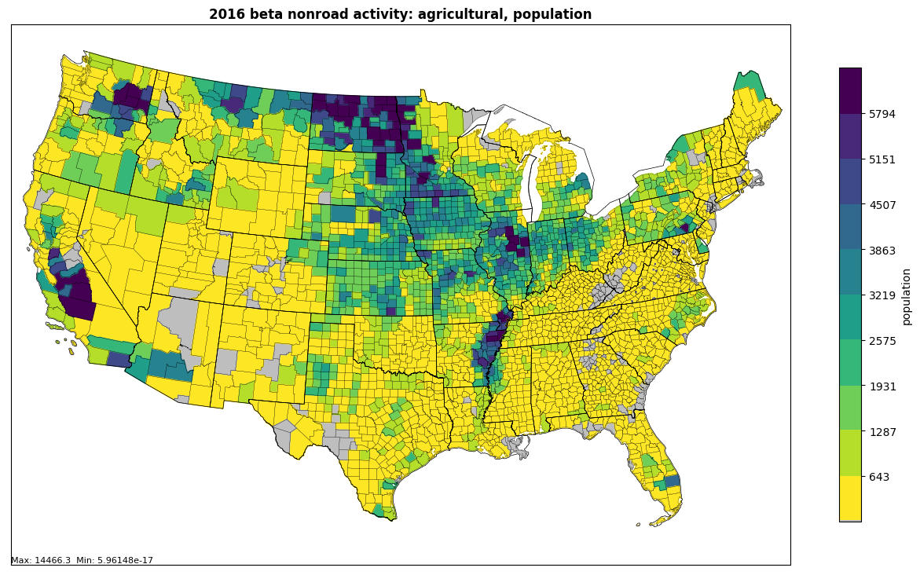
Equipment Populations - Beta Inventory
Total number of Agricultural equipment units (incl. AK, HI, VI, PR): 3,363,267
Dominated by Agricultural Tractors (49.8%), Tillers (25.3%), and Combines (10.3%)

Slide 5
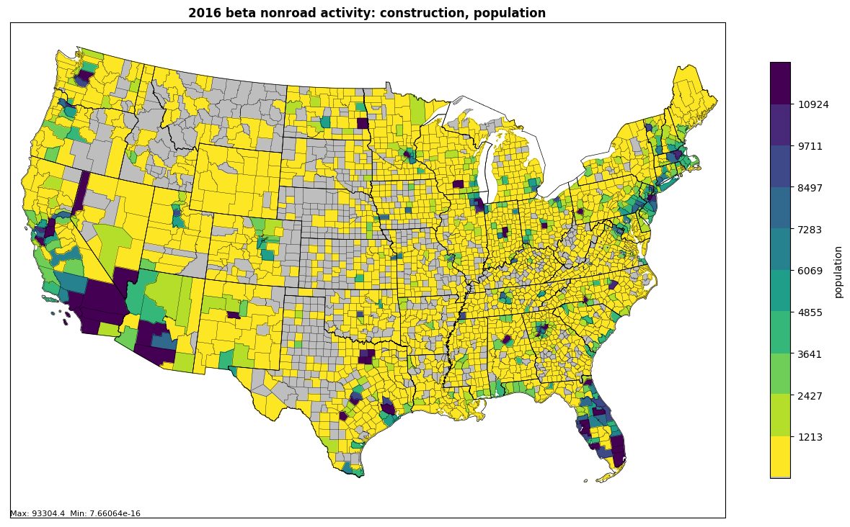
Equipment Populations - Beta Inventory
Total number of Construction equipment units (incl. AK, HI, VI, PR): 3,119,570
Dominated by Skid Steer Loaders (19.7%), Tractors/Loaders/Backhoes (12.7%) and Cement and Mortar Mixers (9.7%)

Slide 6
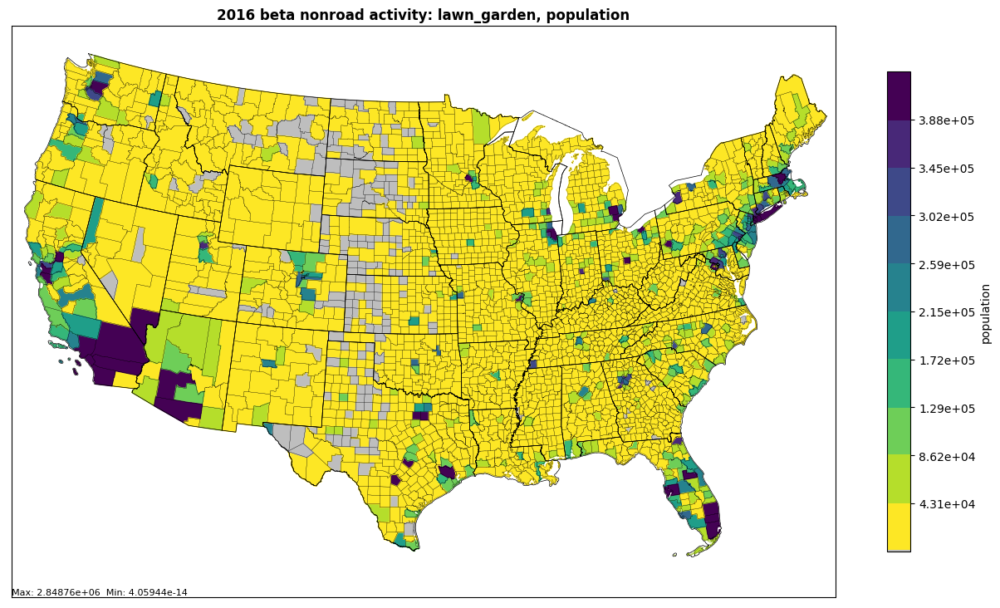
Equipment Populations - Beta Inventory
Total number of Lawn & Garden (Residential + Commercial) equipment units (incl. AK, HI, VI, PR): 111,823,829
Dominated by Residential Lawn Mowers (35.2%), Residential Trimmers/Edgers/Brush Cutters (15.1%) and Residential Lawn and Garden Tractors (13.1%)

Slide 7
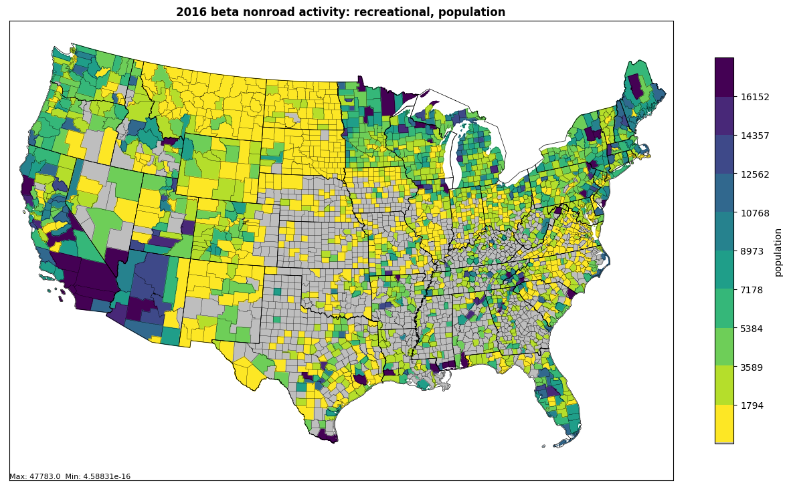
Equipment Populations - Beta Inventory
Total number of Recreational equipment units (incl. AK, HI, VI, PR): 8,514,900
Dominated by ATVs (54.0%), Snowmobiles (20.2%), and Off-road Motorcycles(16.5%)

Slide 8
Nonroad v1 inventory
v1 Timeline
EPA planning to kick-off v1 model runs at the end of February
States planning to submit data should do so by January 15th
Submissions should be sent to Sarah Roberts and Alison Eyth
Work group’s geographic allocation updates should also be completed by January 15th
Progress in Updating Geographic Allocations
Agriculture
Lawn & Garden
Recreational
Construction

Slide 9
Geographic Allocations: Construction
New allocation surrogates developed using three datasets
2016 County Business Patterns (CBP): Number of business establishments corresponding to NAICS 237 (Civil and Heavy Engineering Construction) at the county level
2012 Economic Census: Cost of off-highway use of gasoline and fuel (CSTFUOF) corresponding to NAICS 237 at the state level. CSTFUOF values adjusted by applying Area Modification Factors corresponding to construction material costs. State-level CSTFUOF then allocated to counties using 2016 CBP data used in (1) above.
2014 NEI Construction Dust Estimates: construction dust estimates are a function of acreage disturbed by residential, non-residential, and road construction. Sum of acres disturbed used as surrogate.
Next steps:
Review spreadsheet (‘2016_NAICS 237_NR update3.xlsx’) containing results from all three methods. Available on wiki and Google Drive
Provide feedback to Sarah by next WG meeting (January 3)

Slide 10
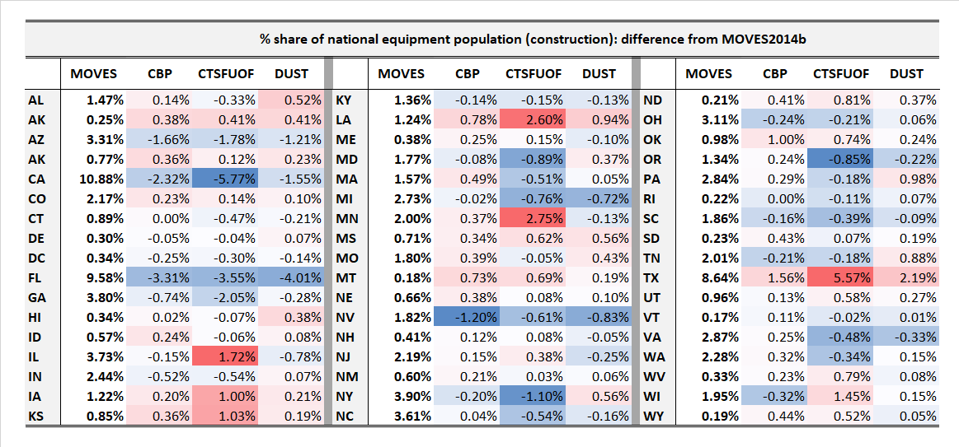
Geographic Allocations: Construction

Slide 11
Other Business / Reminders
Questions and Discussion
Work Group meeting minutes and related files and links available on Work Group wiki:
http://views.cira.colostate.edu/wiki/wiki/9179
Larger data files on Work Group Google Drive and EPA ftp: https://drive.google.com/drive/folders/1Q3s1bqTXt3w2LAd5h-nJeUyMNnHnKjBy
ftp://newftp.epa.gov/air/emismod/2016/beta/reports/nonroad/
Next meeting: January 3rd @ 3:30pm EST

